Slide 1
Schematic Design
Vy. N – C0776242

Slide 2
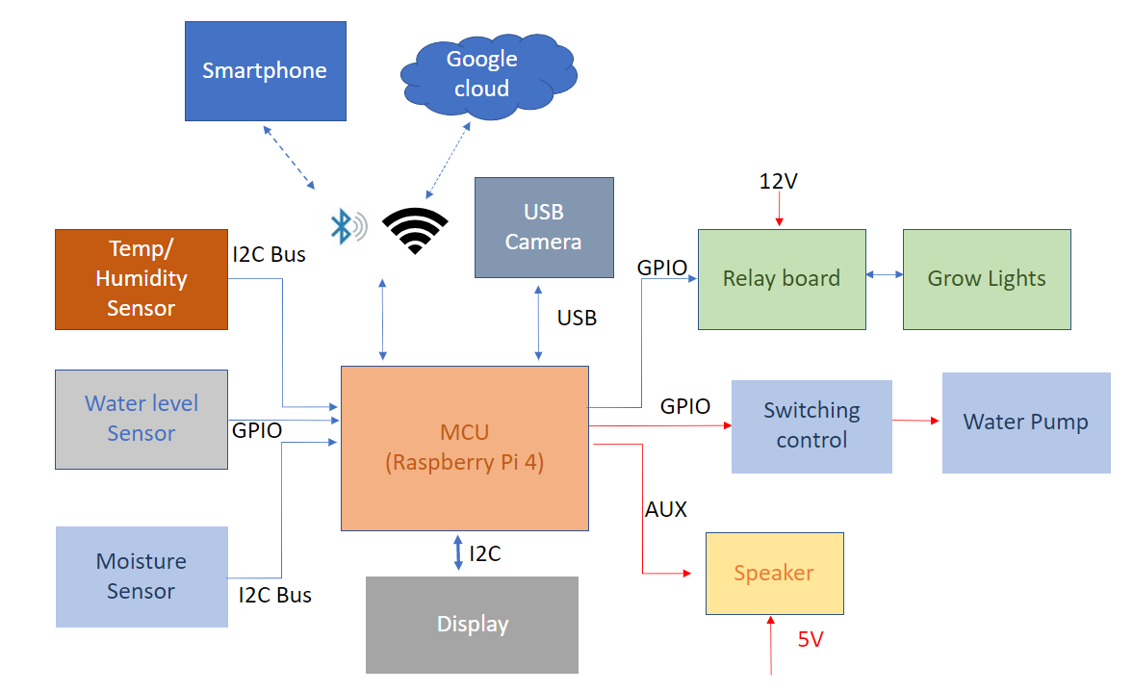
Project summary – Block diagram

Slide 3
Project Summary – Key features
Smartphone control: the device can be monitored and controlled via the BLE system or by smartphone via Wifi and Google Cloud.
Auto-adjusting temperature: with an optional enclosed space, the temperature in each slot of the device can be adjusted to a suitable level for any particular plant.
Auto-adjusting humidity: some plants may enjoy their habitat in a humid environment; our device can replicate the humidifier system’s moist air humidifier system’s moist air-control.
Auto-watering: the plants will never be dried out again with this feature; the device will detect the soil’s humidity and automatically water your plants whenever they need.
Auto-disease-detect: the device will have a camera system that scans the leaves of your plants, then detects any disease happening to the plants, and recommends proper treatment.
Light system: with the LEDs system, the device can save up to 70% of power consumption.
Music player: yes, our device will also have a music function. You wonder why? According to a study, music increases plants’ productivity, and it improves their health and “mood.” (Mazlan, 2020).
Friendly control interface: With a LCD built on, you can easily control your whole garden within a few steps.

Slide 4
Main Components Requirements
Number | Description | Q.ty
1 | Peristaltic Liquid Pump with Silicone Tubing -5V DC Power | 1
2 | HUMIDITY & TEMPERATURE SENSOR BR | 1
3 | CAPACITIVE SOIL MOISTURE SENSOR V1.2 | 1
4 | Ultrasonic sensor | 1
5 | Ultra-Flexible White LED Strip - 480 LED per meter - 1m long - - Cool White ~6000K | 1
6 | Raspberry Pi 4 Model B - 4 GB RAM | 1

Slide 5
Main Components Requirements
Number | Description | Q.ty
7 | STANDARD LCD 16X2 + EXTRAS - WHITE ON BLUE | 1
8 | I2C / SPI CHARACTER LCD BACKPACK | 1
9 | ADS1115 | 1
10 | 12V RELAY | 2

Slide 6
EasyEDA - Introduction
What is EasyEDA?
EasyEDA is a web-based EDA tool suite that enables hardware engineers to design, simulate, share - publicly and privately - and discuss schematics, simulations and printed circuit boards. Other features include the creation of a bill of materials, Gerber files and pick and place files and documentary outputs in PDF, PNG and SVG formats.
EasyEDA allows the creation and editing of schematic diagrams, SPICE simulation of mixed analogue and digital circuits and the creation and editing of printed circuit board layouts and, optionally, the manufacture of printed circuit boards.[

Slide 7
EasyEDA - Features
EasyEDA is an integrated browser-based tool for schematic capture, SPICE circuit simulation, based on Ngspice, and PCB layout.
Import from Altium Designer, CircuitMaker, Eagle, Kicad and LTspice file formats as well as generic SPICE netlists is supported. SPICE netlists can be exported to third party simulation tools and export of PCB netlists in Altium, PADS and FreePCB formats is also supported.

Slide 8
EasyEDA- KiCAD Comparison
Features | KiCAD | EasyEDA
Platform Type | Need to be installed, larger size, run on all major OS | Online, can access on any browser, allow to store on Cloud
Libraries | Libraries package need to be download. Have a Github repository where you can upload your own libraries. | Libraries with more than one millions parts. Have information like pricing, stock quantity, …
User Interface | KiCAD UI has modern looking and better color coded. Tools are easy to find, and quick access. KiCAD is open source | Basic UI, simple color scheme. It has features to filter and search for projects, parts, files, etc.
Routing the PCB | You can use the PCBNew module, which handles layout and routing tasks. | You can use online platform for routing, or download a package which allows you to use manual and auto- routing on desktop

Slide 9
EasyEDA- KiCAD Comparison (cont)
Features | KiCAD | EasyEDA
Team Collaboration | Does not have this feature. | Has cloud-based online working feature, anyone on the team can edit it in real time.
Schematic Features | KiCAD includes Eeschema, its module for all schematic related tasks. Eeschema allows to wok with all major formats. You can export to PDF, SVG, HPGL Can work with multi-layer schematic, has hierarchical schematic conversion feature. | Easy draw symbol from scratch, or use existing symbols by editing them. Also has 3D components symbols.
3D Viewing | Simple converting between 2D and 3D. | Also have a 3D modeling feature set, but it is comparatively in terms of functionality.

Slide 10
EasyEDA- KiCAD Comparion (cont)
Feature | KiCAD | EasyEDA
Additional Features | Includes Gerber files for manufacturing, Customizable hotkeys feature, you can edit existing shortcut keys or define custom key to acts. | Includes Gerber files for manufacturing Has special feature, which relates to creating custom shape

Slide 11
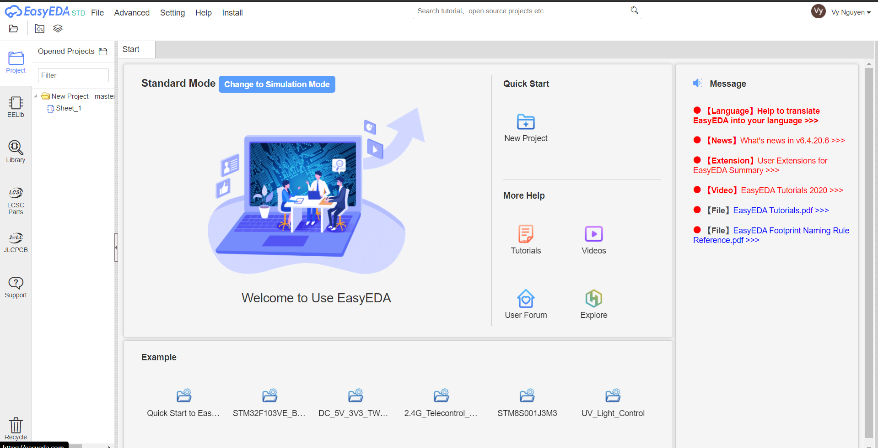
EasyEDA – Designer UI

Slide 12

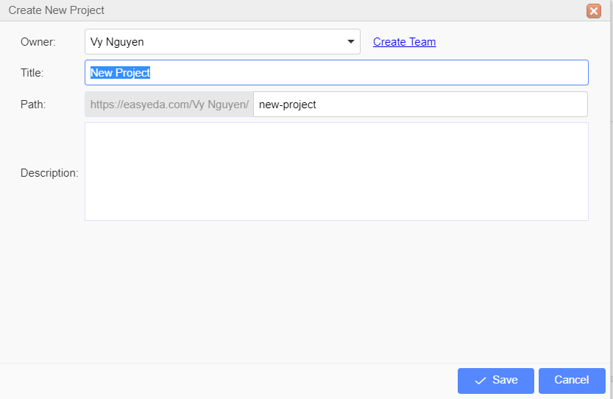
EasyEDA – New Design
For creating new project, choosing New: Project in Quick Start
Fill the “Title” for the name of the project.
Fill the additonal boxes:
“Owner” box
“Path” box
“Description” box

Slide 13
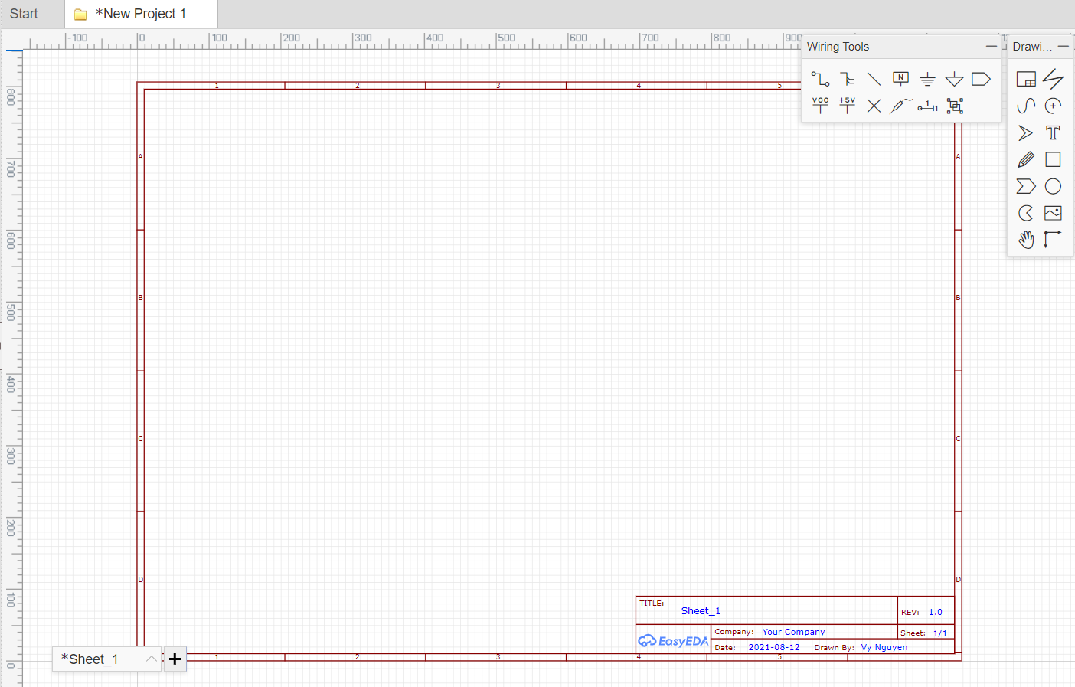
EasyEDA –Design Schematic
Main Schematic sheet:

Slide 14
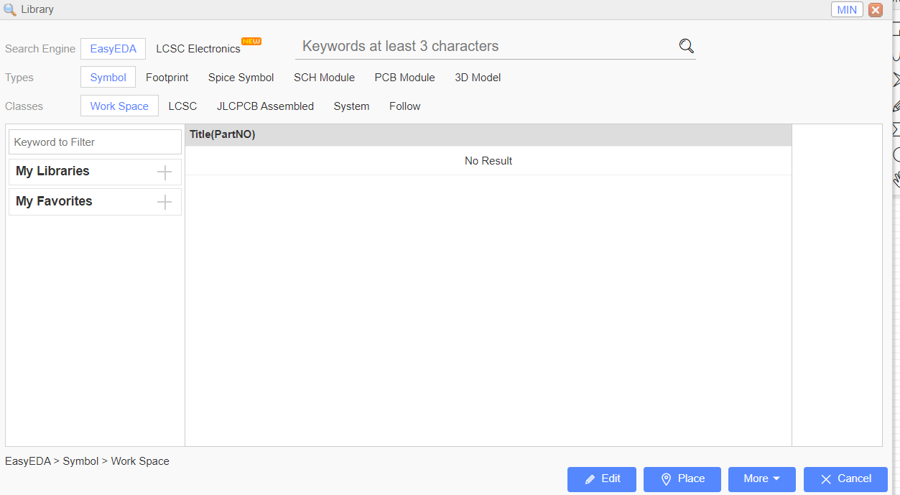
EasyEDA –Design Schematic (cont.)
Adding components by Right Click -> Place Components.
From library, searching for the components needed.

Slide 15
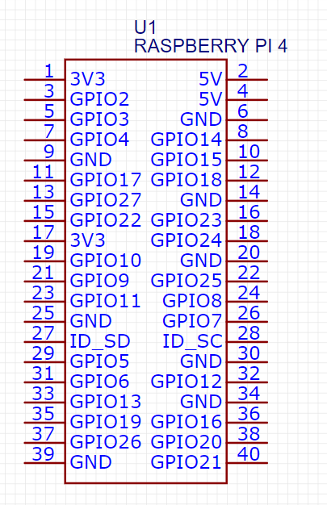
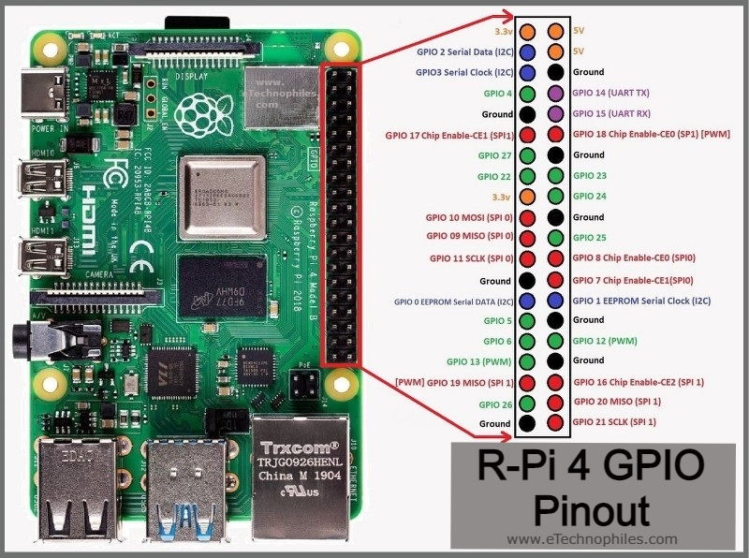
EasyEDA –Design Schematic (cont.)
Main MCU – Raspberry Pi 4

Slide 16
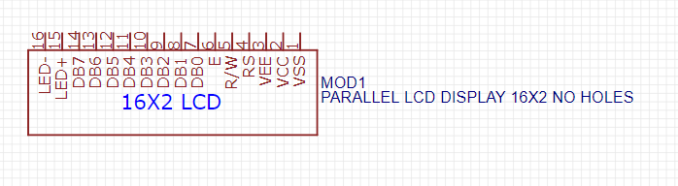
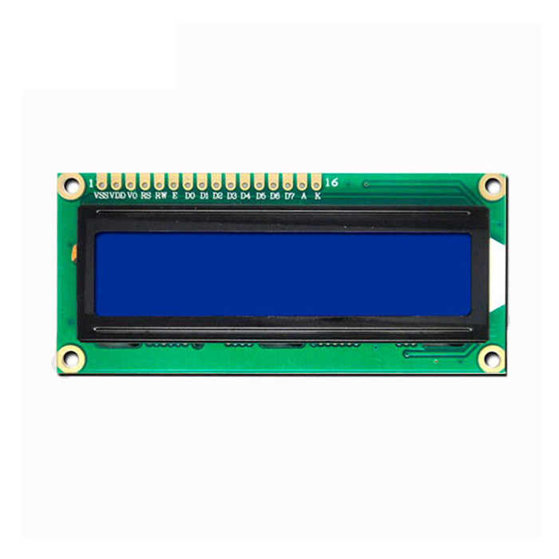
EasyEDA –Design Schematic (cont.)
LCD 16x3 with I2c

Slide 17
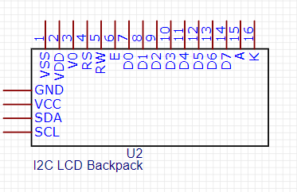
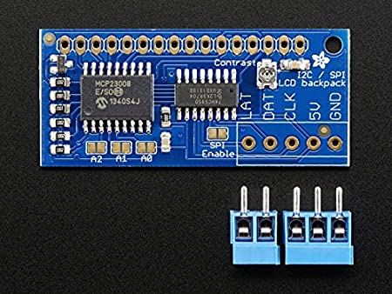
EasyEDA –Design Schematic (cont.)
I2C Backpack

Slide 18
EasyEDA –Design Schematic (cont.)
In this section, we will talk about the LCD and Raspberry interfacing via I2c communication.
The idea of this system will be illustrated like the block diagram below:
LCD Display
(HD44780)
I2C/SPI – Backpack (MCP23008)
Raspberry Pi 4
GPIO
I2C

Slide 19
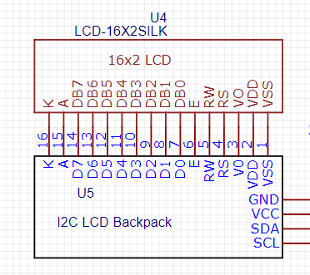
EasyEDA –Design Schematic (cont.)

Slide 20
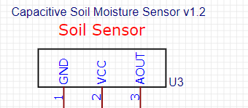
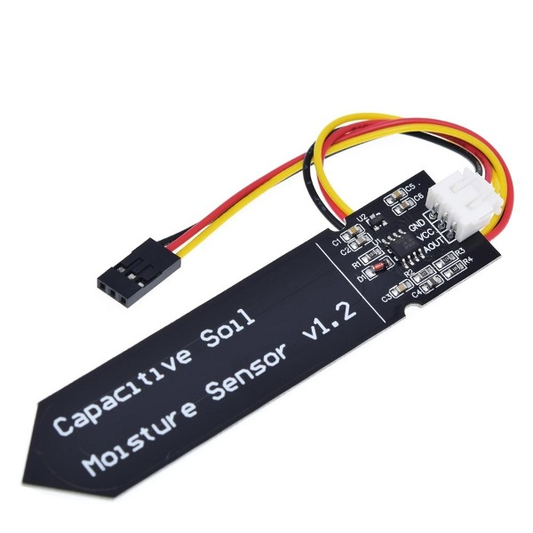
EasyEDA –Design Schematic (cont.)
Capacitive Soil Moisture Sensor v1.2

Slide 21
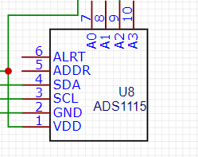
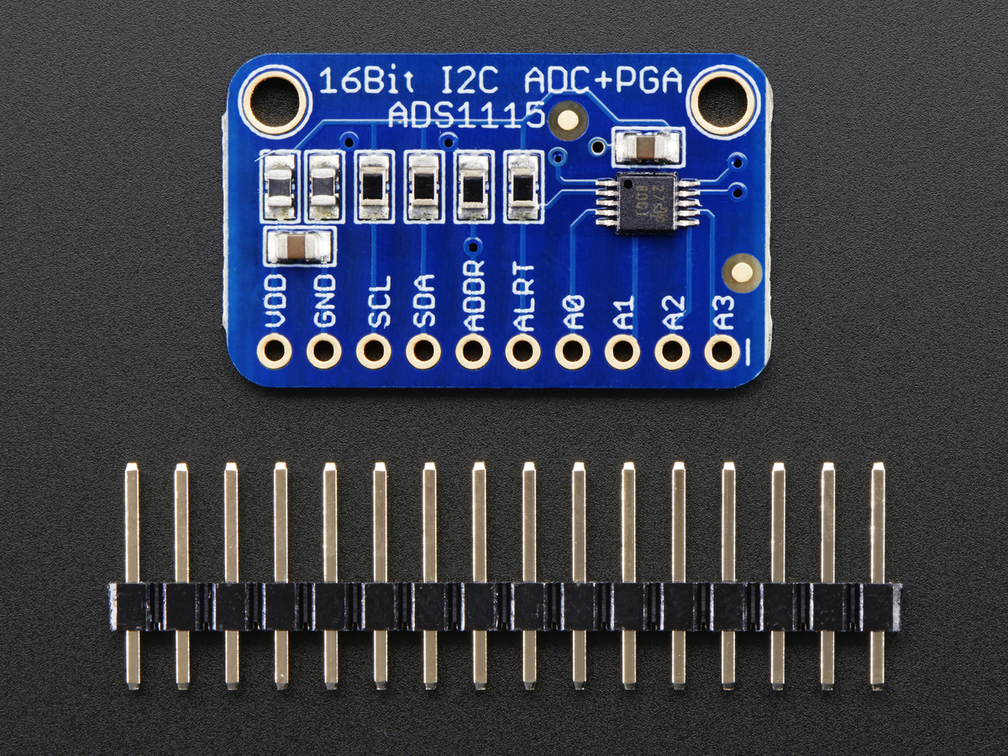
EasyEDA –Design Schematic (cont.)
ADC – ADS1115

Slide 22
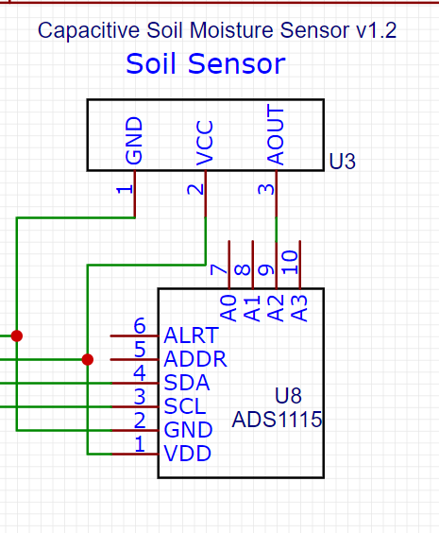
EasyEDA –Design Schematic (cont.)
Soil Moisture sensor v1.2 and ADS1115 Connection will be like this:
The interfacing will work as from Analog signal of senor -> convert into Digital signal -> send to MCU via I2C com.

Slide 23
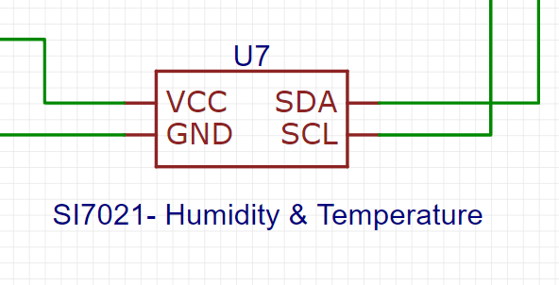
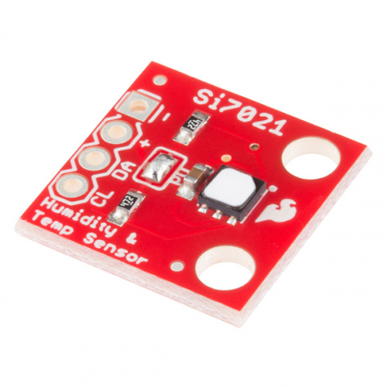
EasyEDA –Design Schematic (cont.)
Si7021 – Humidity & Temperature Sensor

Slide 24
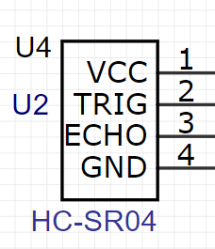
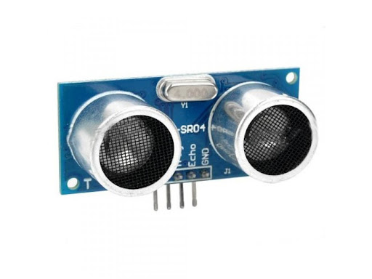
EasyEDA –Design Schematic (cont.)
Ultrasonic Sensor – Water Level detection

Slide 25
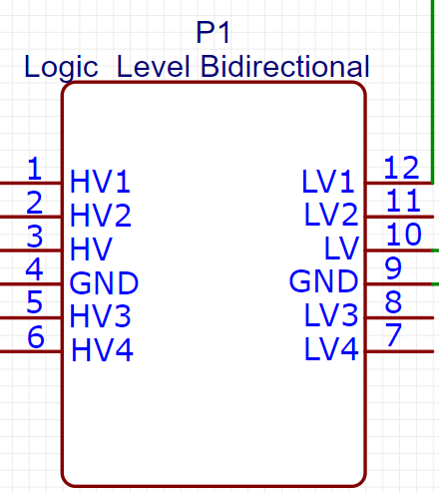
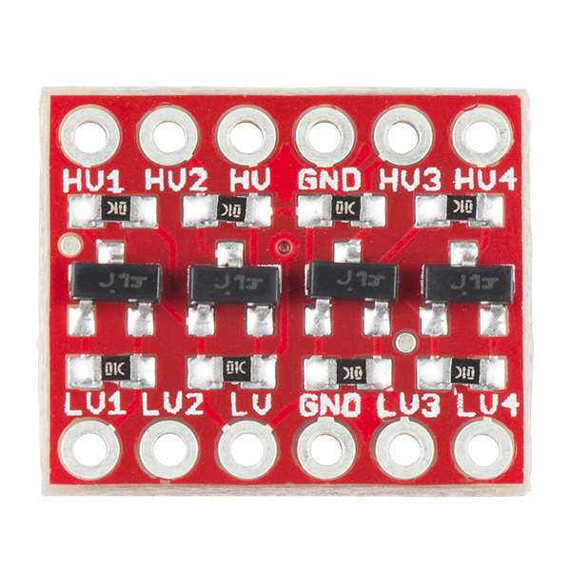
EasyEDA –Design Schematic (cont.)
Logic Level Bidirectional Converter

Slide 26
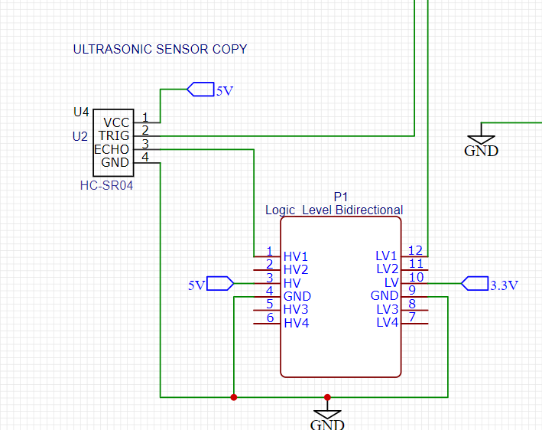
EasyEDA –Design Schematic (cont.)
HR-S04 Ultrasonic sensor will connect to the MCU via a level converter, to protect the MCU.

Slide 27
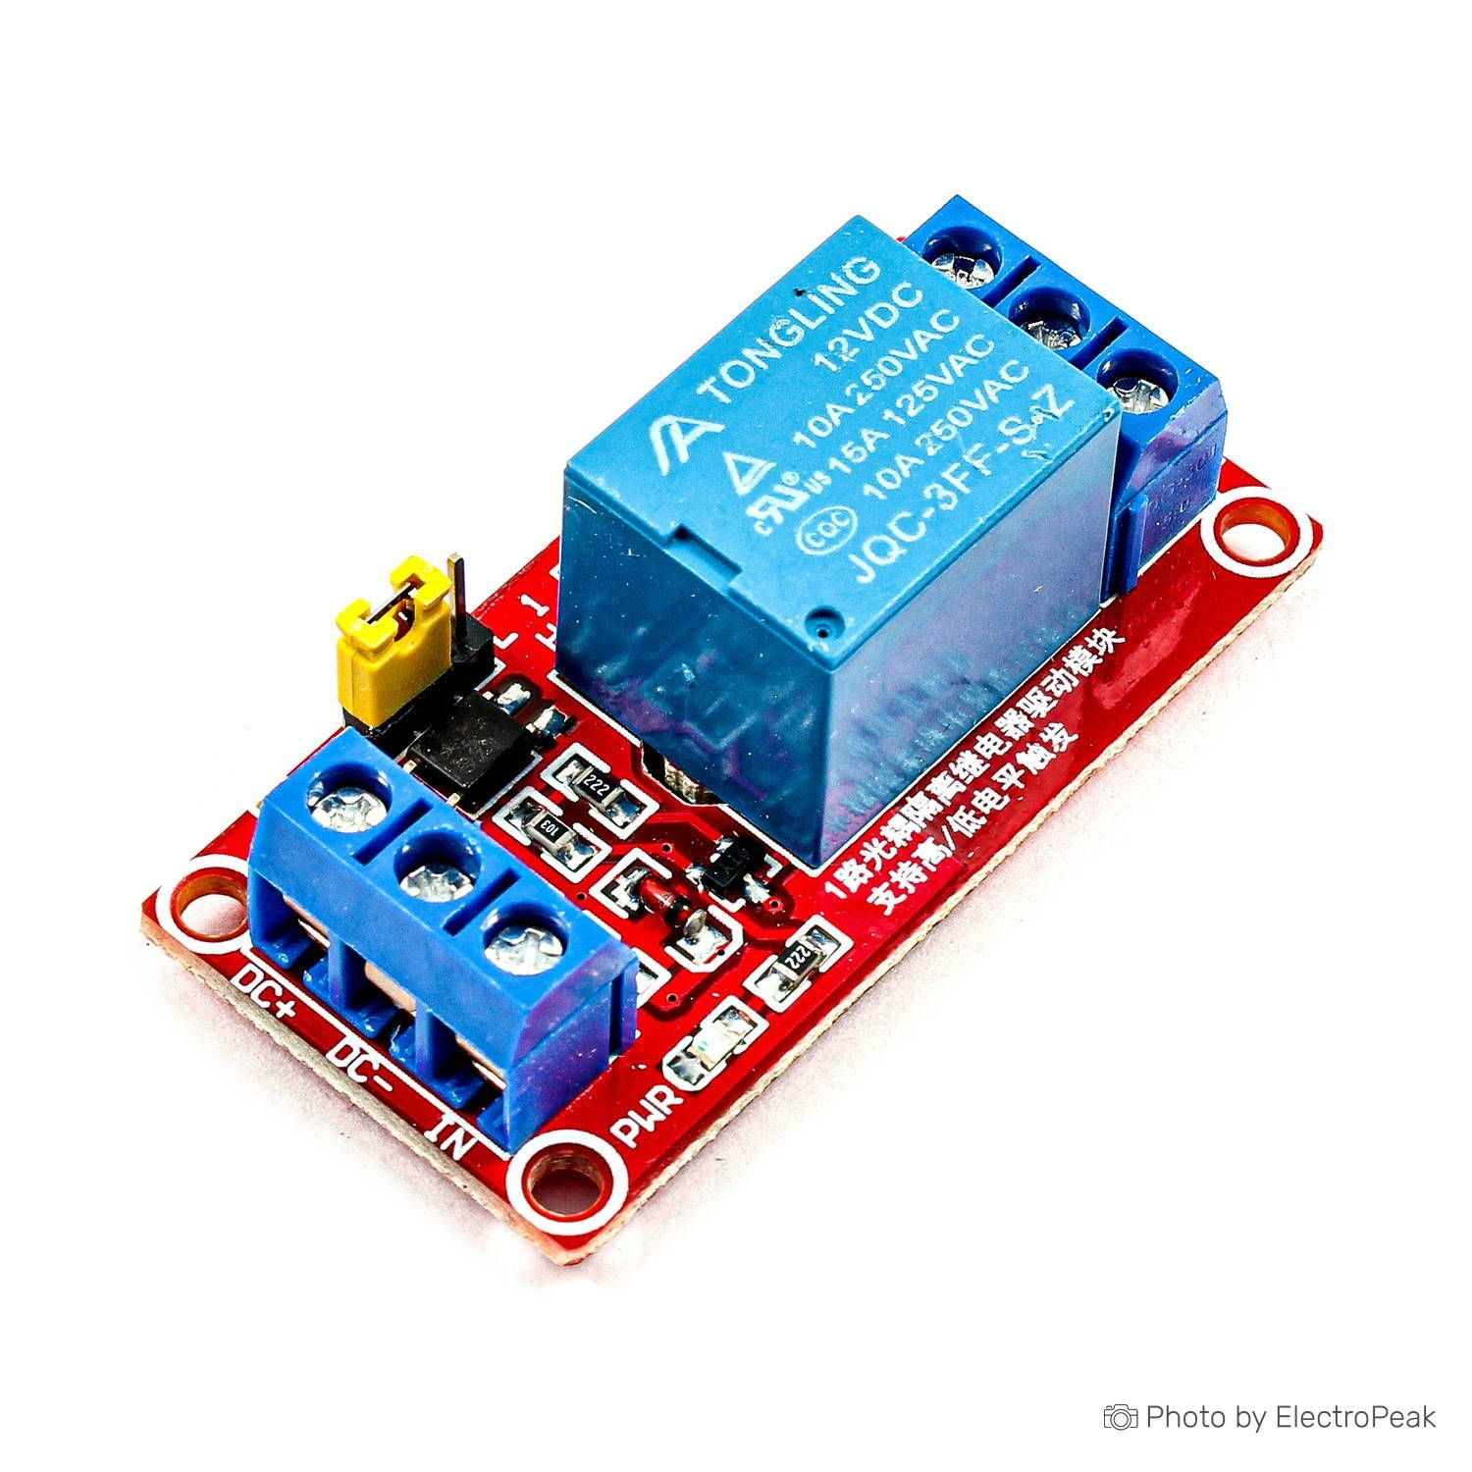
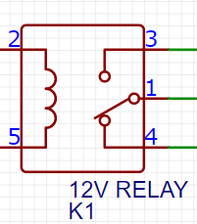
EasyEDA –Design Schematic (cont.)
12 V Relay

Slide 28
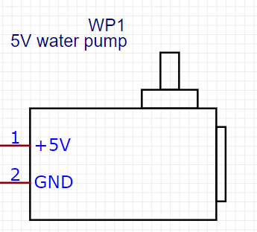
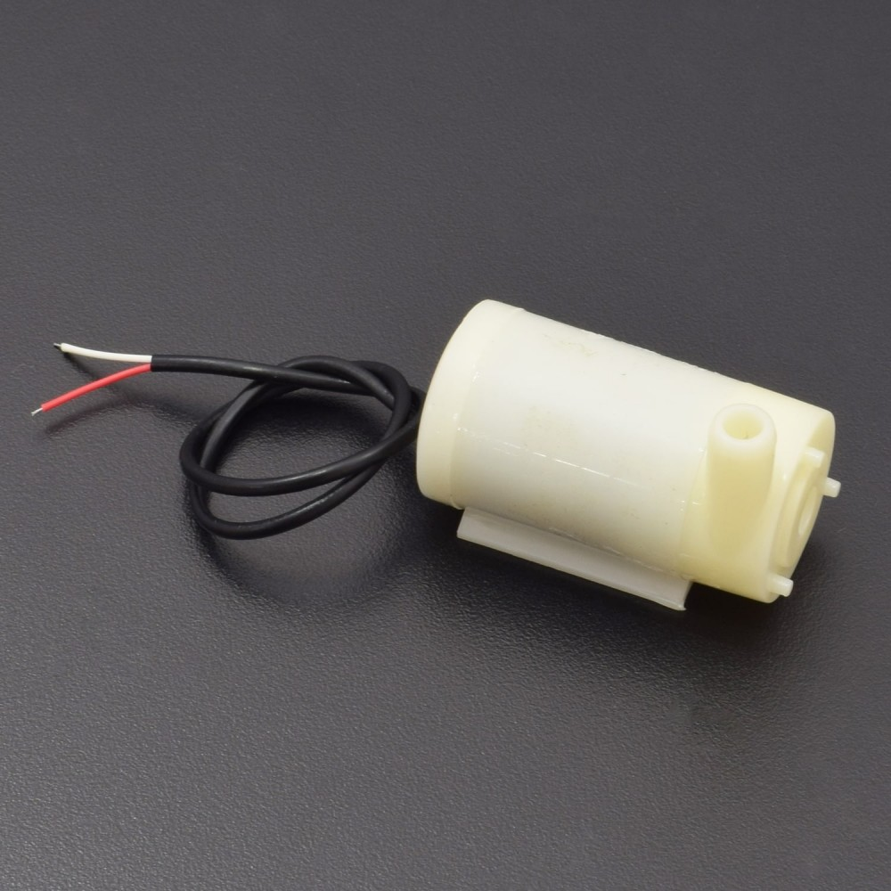
EasyEDA –Design Schematic (cont.)

Slide 29
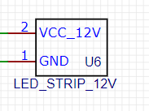
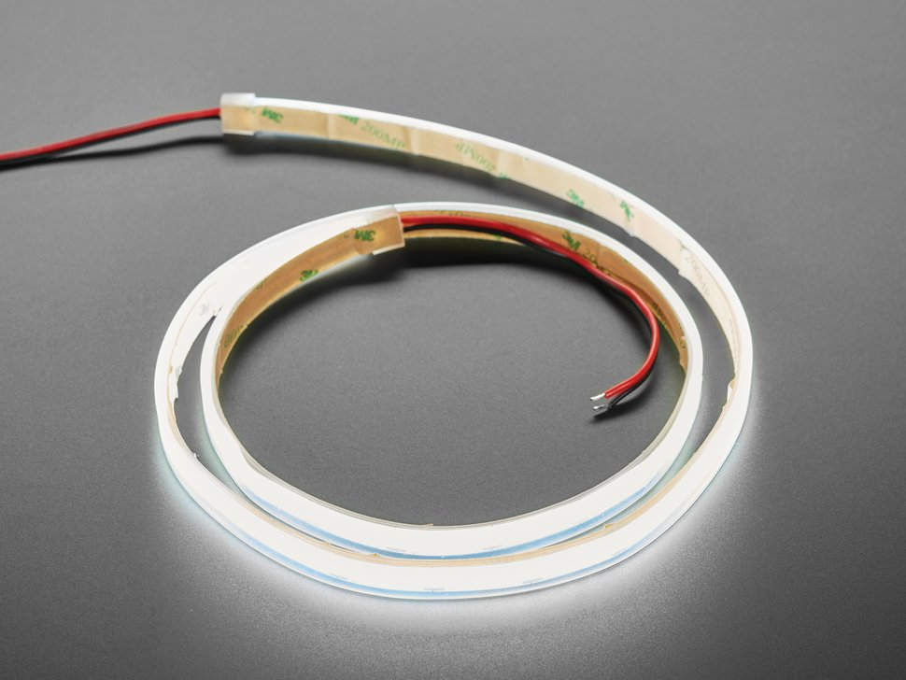
EasyEDA –Design Schematic (cont.)
LED Strip

Slide 30
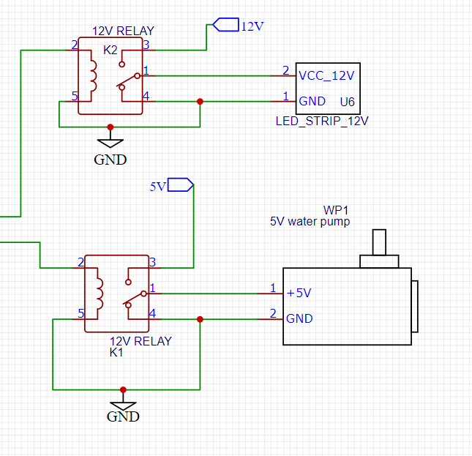
EasyEDA –Design Schematic (cont.)
LED Strip and Water pump will be control via 12v relays

Slide 31
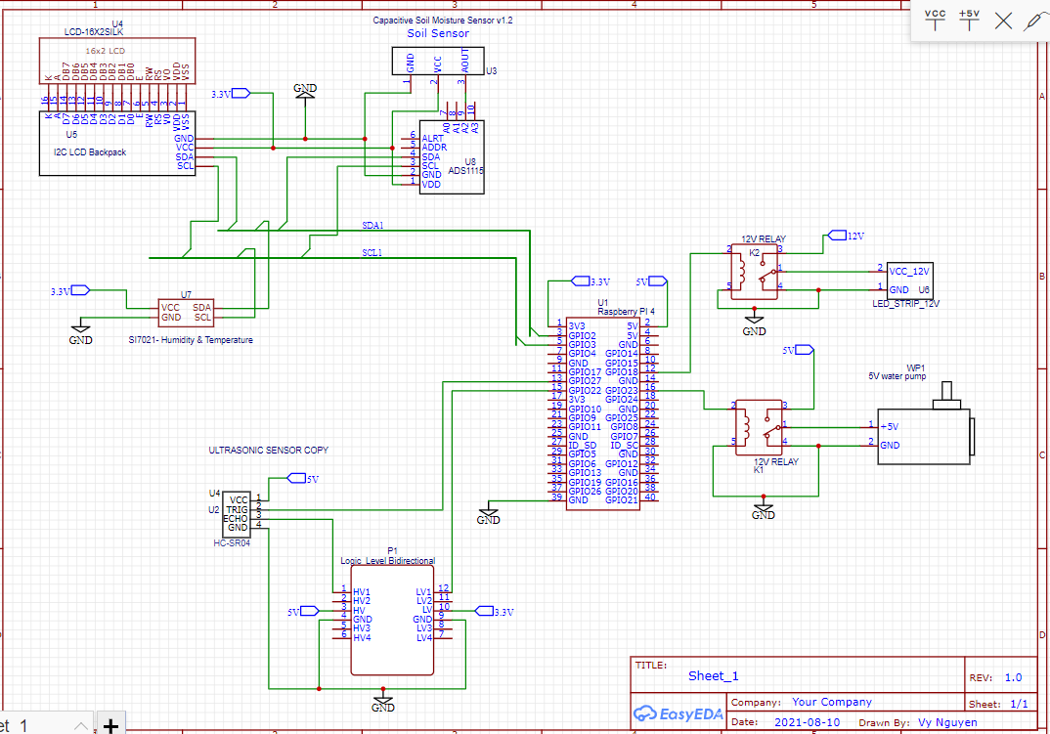
EasyEDA –Design Schematic (cont.)

Slide 32
References
Alan. (2021, March 21). EasyEDA vs Kicad: 8 major Differences? [2021] [updated]. Software Radius. https://www.softwareradius.com/easyeda-vs-kicad/.
Analog capacitive soil moisture SENSOR V1.2 wide VOLTAGE corrosion resistant with cable for ARDUINO Raspberry Pi. Amazon.ca: Electronics. (n.d.). https://www.amazon.ca/Capacitive-Moisture-Corrosion-Resistant-Raspberry/dp/B07FLR13FS.
Industries, A. (n.d.). I2C / spi character lcd backpack. adafruit industries blog RSS. https://www.adafruit.com/product/292.
Industries, A. (n.d.). Peristaltic liquid pump with Silicone Tubing - 12V dc power. adafruit industries blog RSS. https://www.adafruit.com/product/1150.
Industries, A. (n.d.). Raspberry Pi 4 Model B - 4 GB RAM. adafruit industries blog RSS. https://www.adafruit.com/product/4296.
Industries, A. (n.d.). Standard lcd 16x2 + extras. adafruit industries blog RSS. https://www.adafruit.com/product/181.
Industries, A. (n.d.). Ultra flexible White led strip - 480 Led per meter - 1m long. adafruit industries blog RSS. https://www.adafruit.com/product/4612.
SEN-13763. DigiKey. (n.d.). https://www.digikey.ca/en/products/detail/sparkfun-electronics/SEN-13763/6023505.
Sen-15569. DigiKey. (n.d.). https://www.digikey.ca/en/products/detail/sparkfun-electronics/SEN-15569/10384560.

